Slide 1

Customer Shopping Behavior Analysis
Uncovering insights from 3,900 purchases to guide strategic business decisions through data-driven analysis of spending patterns, customer segments, and product preferences.

Slide 2

DATASET OVERVIEW
The Foundation: Our Data
3,900
18
50
Total Purchases
Data Points
Locations
Transactions analyzed
Features per purchase
Geographic coverage
Key Features Tracked
Customer demographics (Age, Gender, Location)
Purchase details (Item, Category, Amount, Season)
Shopping behavior (Discounts, Reviews, Frequency)
Subscription and shipping preferences

Slide 3

PYTHON ANALYSIS
Data Preparation & Cleaning
01
Data Loading & Exploration
Imported dataset using pandas, checked structure with df.info() and summary statistics
02
Missing Data Handling
Imputed 37 missing Review Rating values using median rating per product category
03
Feature Engineering
Created age_group bins and purchase_frequency_days columns for deeper analysis
04
Database Integration
Connected to PostgreSQL and loaded cleaned data for SQL business analysis

Slide 4
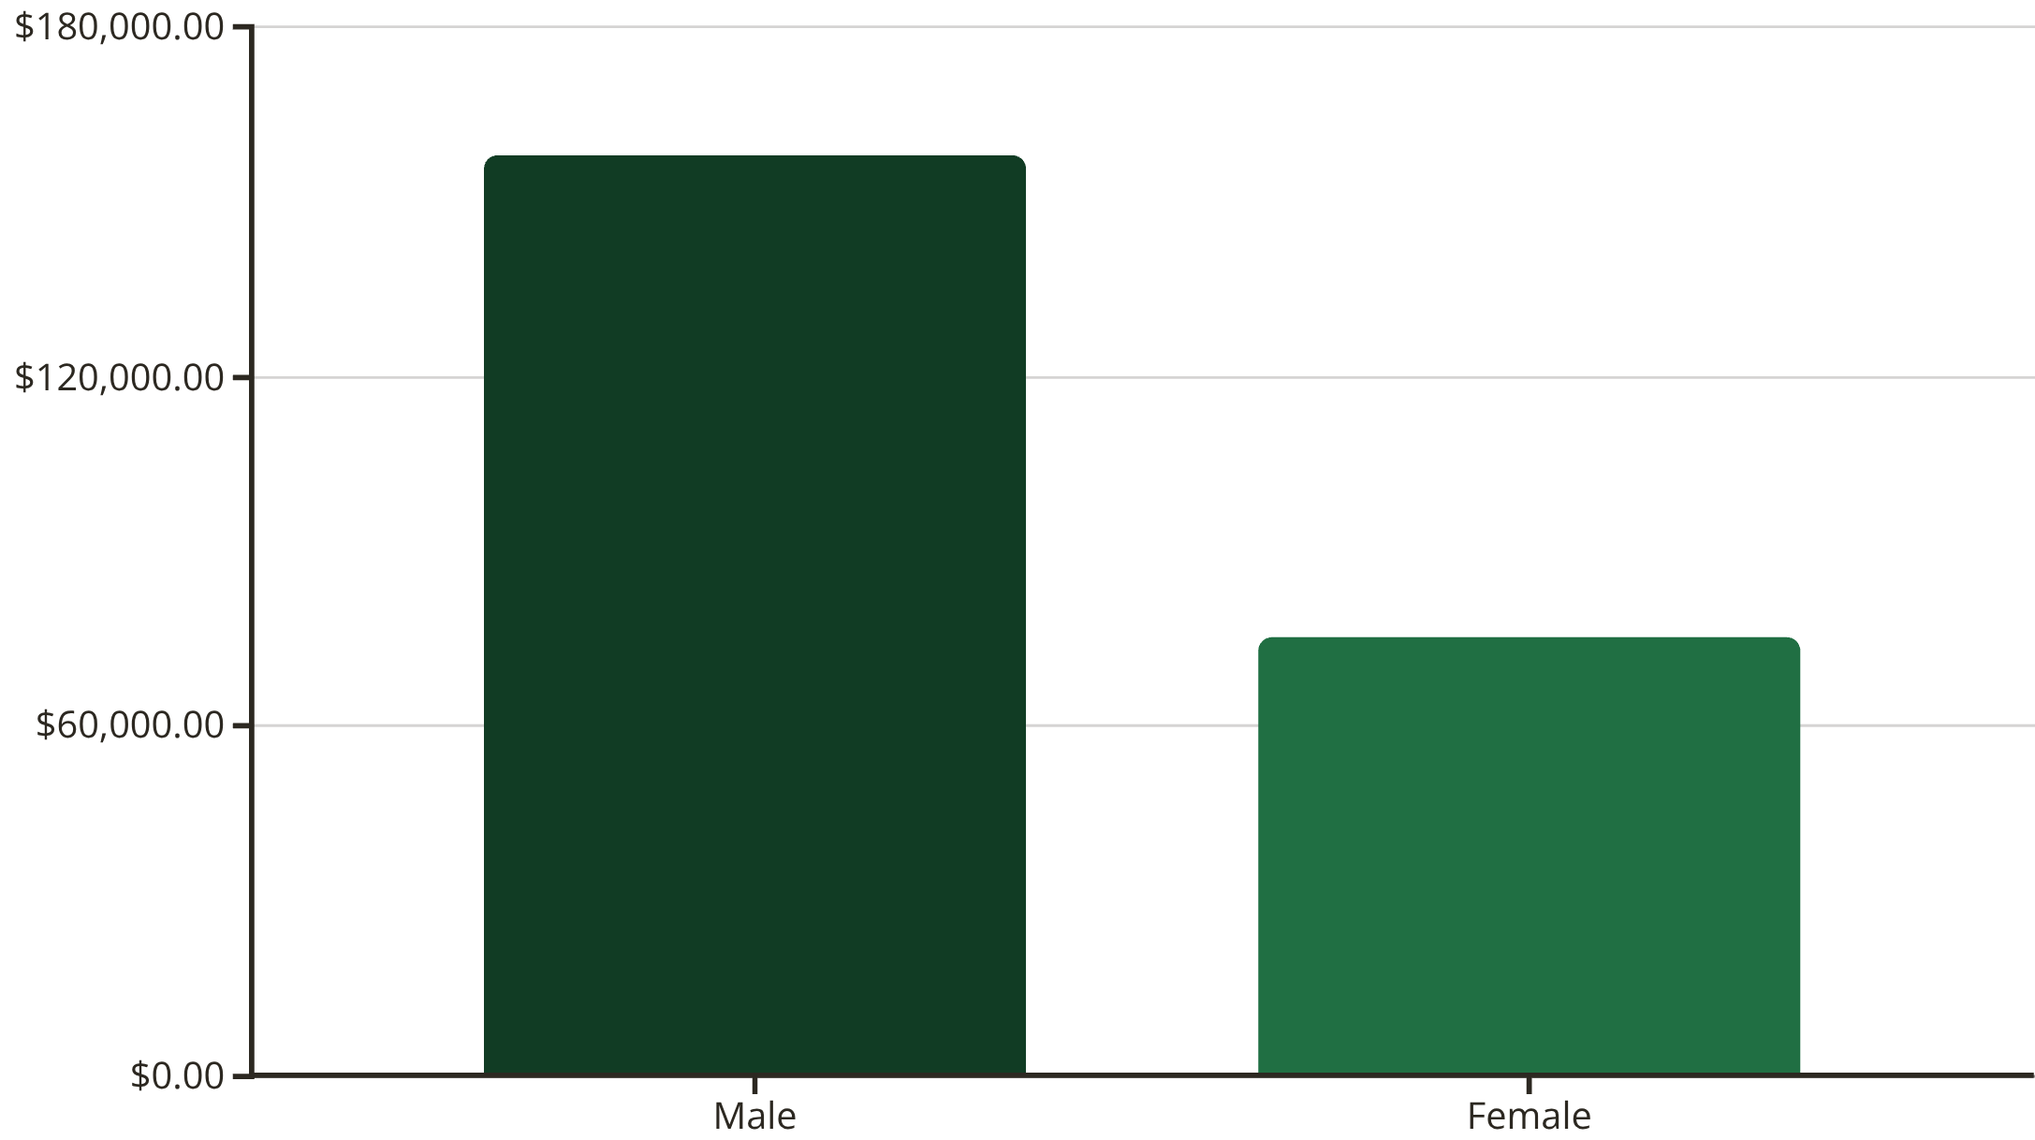
Revenue Insights by Gender
Male Customers Drive Revenue
Male customers generate 68% of total revenue ($157,890) compared to female customers ($75,191), representing a significant opportunity for targeted marketing strategies.

Slide 5





TOP PERFORMERS
Product Excellence: Top-Rated Items
Gloves
Sandals
Boots
Hat
Average rating: 3.86
Average rating: 3.84
Average rating: 3.82
Average rating: 3.80
Skirt
Average rating: 3.78

Slide 6
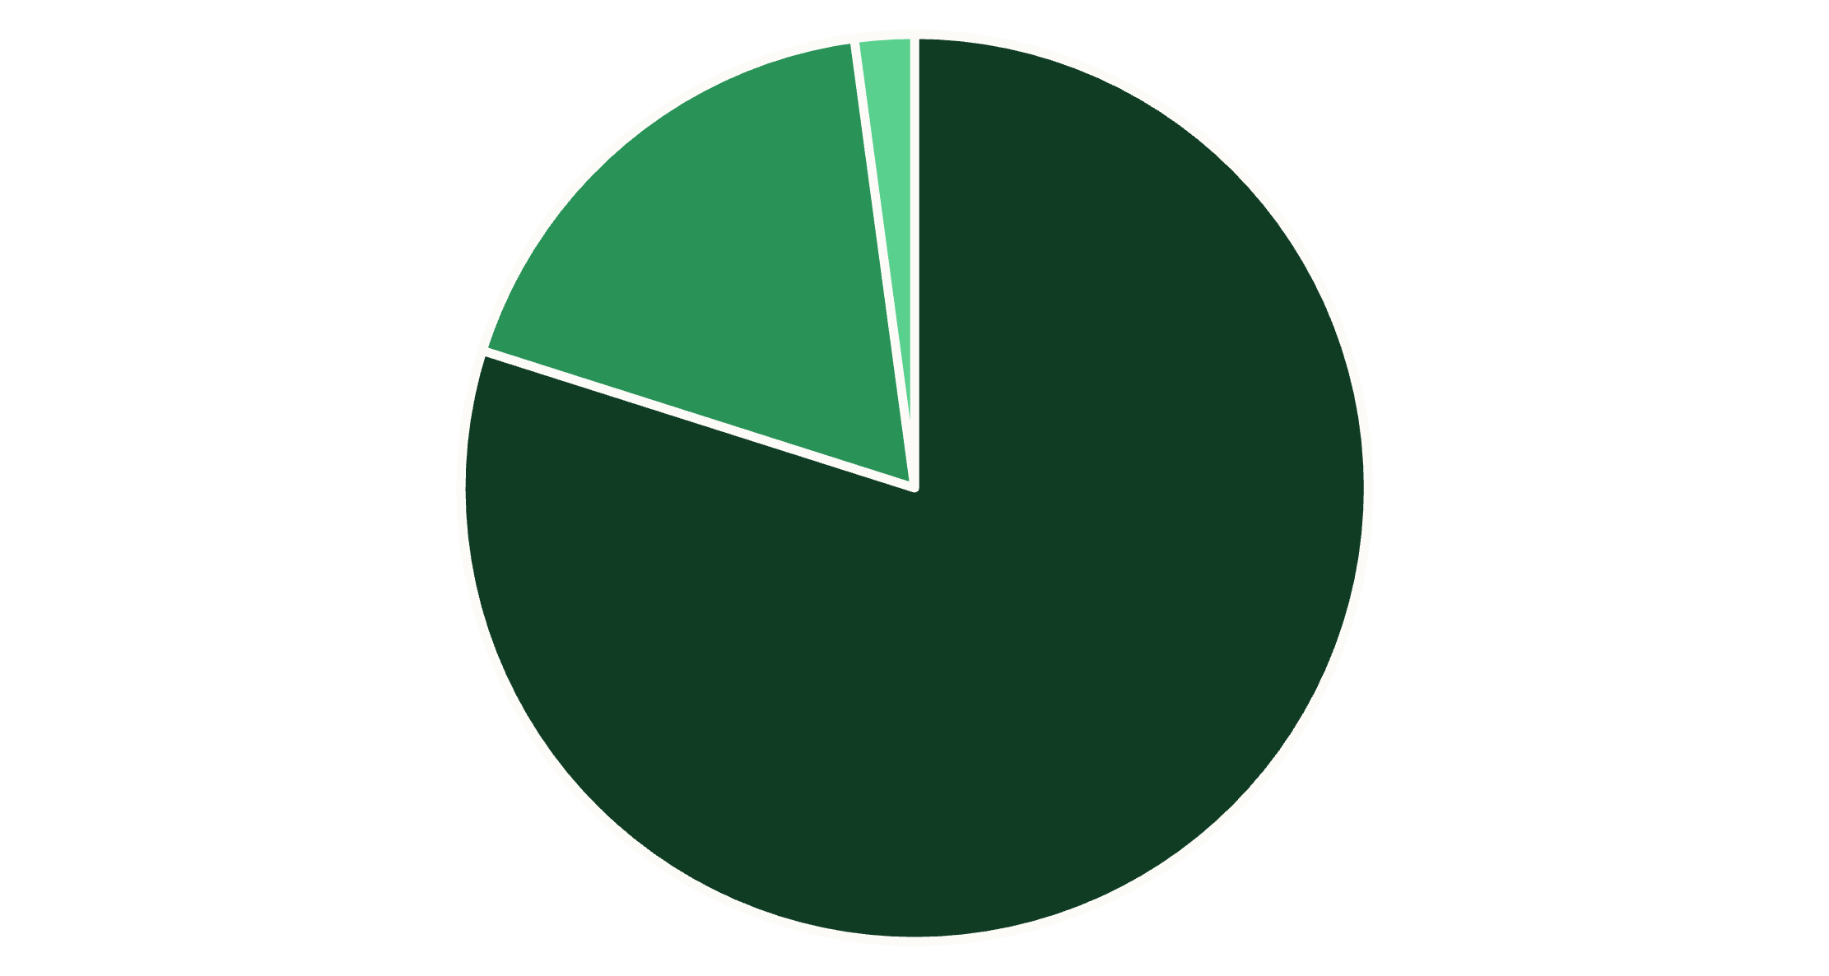
Customer Segmentation Analysis
Loyalty Dominates
80% of customers are classified as Loyal (3,116), with 18% Returning (701) and only 2% New (83). This strong loyalty base presents opportunities for retention programs and upselling.
Loyal
Returning
New
Loyal: 80%
Returning: 18%
Repeat purchasers
Growth potential

Slide 7
Age Group Revenue Distribution
27%
25%
Young Adult
Middle-aged
$62,143 total revenue
$59,197 total revenue
24%
24%
Adult
Senior
$55,978 total revenue
$55,763 total revenue

Slide 8
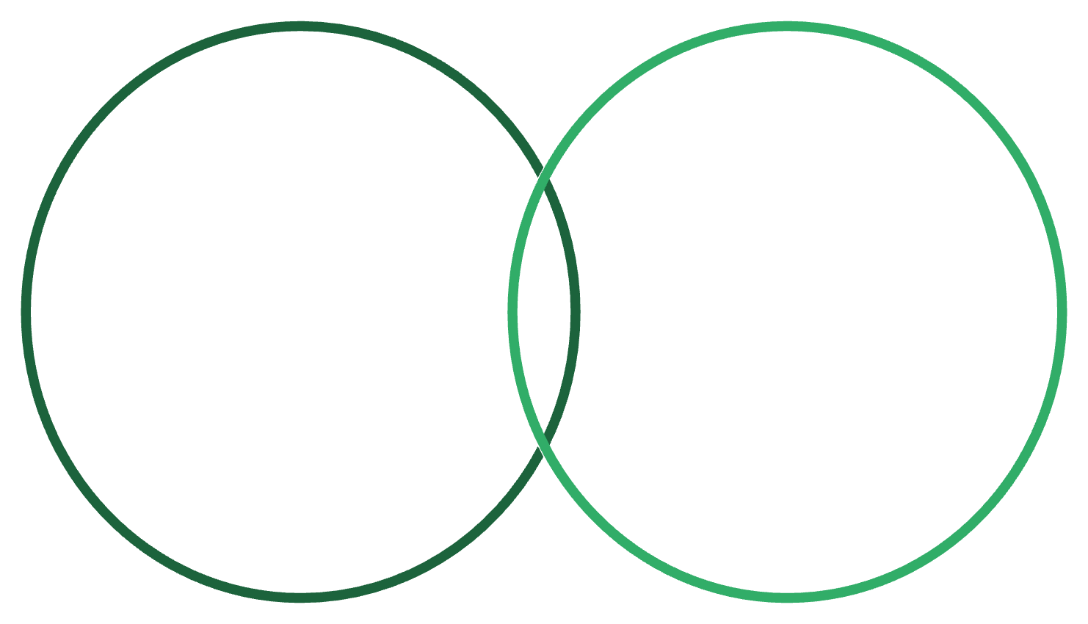
DISCOUNT ANALYSIS
Smart Discounting Strategy
Top Discount-Dependent Products
Discount-Dependent Products
High-Spending Discount Users
Hat: 50% of purchases discounted
Sneakers: 49.66% discounted
Coat: 49.07% discounted
Sweater: 48.17% discounted
Pants: 47.37% discounted
839 customers spent above $59.76
Hat 50%, Sneakers 49.66%, Coat 49.07%
839 customers used discounts but still spent above the $59.76 average, showing discounts attract quality buyers.
Balance promotional strategy to protect margins while driving volume.

Slide 9
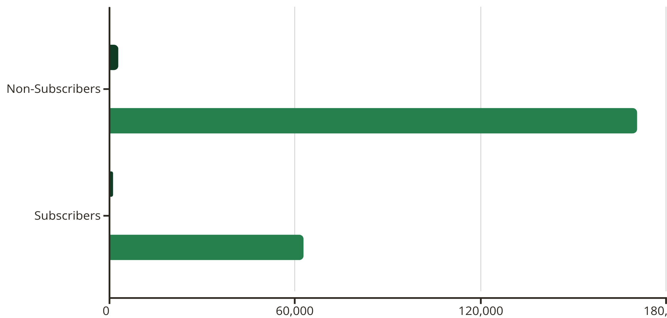
Subscription Impact Analysis
Subscription Opportunity
Only 27% subscribe despite similar spending patterns. Of 3,476 repeat buyers (>5 purchases), 958 are subscribers—huge growth potential.
Customers
Avg Spend
Total Revenue

Slide 10

ACTION PLAN
Strategic Recommendations
Boost Subscriptions
Loyalty Programs
Promote exclusive benefits to convert the 73% non-subscribers, especially among repeat buyers
Reward the 80% loyal customer base to increase lifetime value and referrals
Review Discount Policy
Targeted Marketing
Balance margin protection with volume on discount-dependent products like hats and sneakers
Focus on male customers and Young Adults who drive 27% of revenue, highlight top-rated products

